Slide 1

The open window (after H. Munro)

Slide 2
Resort
[rɪˈzɔːt]
Guess the meaning of the word

Slide 3
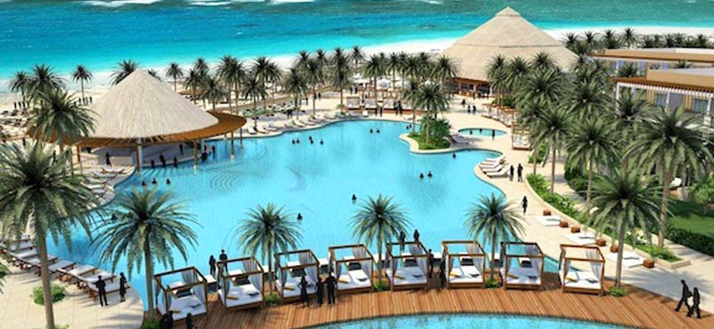
Give the definition

Slide 4
a place where people go for vacations
something that you choose for help
the act of doing or using something especially because no other choices are possible
The definition of the word

Slide 5
To owe
[əʊ]
Guess the meaning of the word

Slide 6
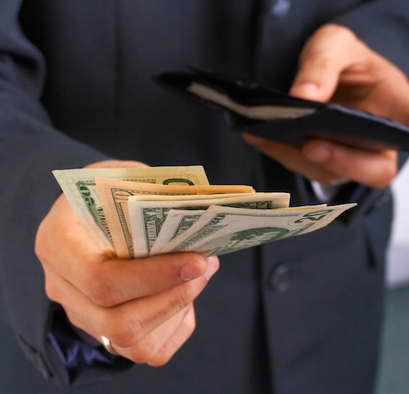
Give the definition

Slide 7
to need to pay or repay money to a person, bank, business, etc.
to need to do or give something to someone who has done something for you or given something to you
used to say that something should be done for or given to someone
The definition of the word

Slide 8
Shooting
[ˈʃuːtɪŋ]
Guess the meaning of the word

Slide 9
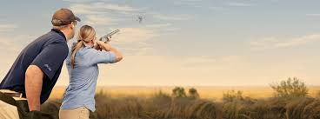
Give the definition

Slide 10
The action or practice of shooting
Moving or growing quickly
The definition of the word

Slide 11
introduction
[ˌɪntrəˈdʌkʃ(ə)n]
Guess the meaning of the word

Slide 12

Give the definition

Slide 13
the act or process of introducing : the state of being introduced
The definition of the word

Slide 14
Gather
[ˈɡæðə]
Guess the meaning of the word

Slide 15
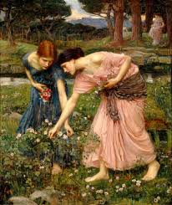
Give the definition

Slide 16
to bring (things or people) together into a group
to choose and collect (things)
to get or take (things) from different people or places and bring them together
The definition of the word

Slide 17
Gaily
[ˈɡeɪlɪ]
Guess the meaning of the word

Slide 18
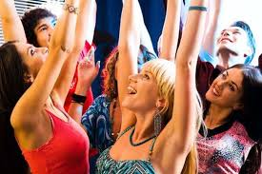
Give the definition

Slide 19
in a happy and lively way
in a bright and colorful way
The definition of the word

Slide 20
Seize
[siːz]
Guess the meaning of the word

Slide 21
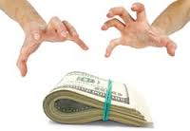
Give the definition

Slide 22
to use legal or official power to take (something)
to get or take (something) in a sudden or violent way
to attack and take control of (a place) by force or violence
The definition of the word

Slide 23
Cemetery
[ˈsɛmətrɪ]
Guess the meaning of the word

Slide 24
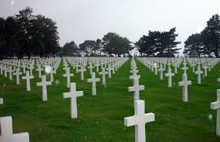
Give the definition

Slide 25
a place where dead people are buried
The definition of the word

Slide 26
to invent
[ɪnˈvɛnt]
Guess the meaning of the word

Slide 27
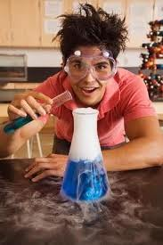
Give the definition

Slide 28
to create or produce (something useful) for the first time
to create or make up (something, such as a story) in order to trick people
The definition of the word

Slide 29
Amusing
[əˈmjuːzɪŋ]
Guess the meaning of the word

Slide 30
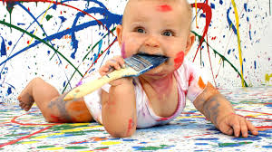
Give the definition

Slide 31
causing laughter or enjoyment
funny or enjoyable
The definition of the word

