Slide 1
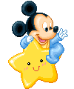
Symbolic calendar days of rest and celebrations

Slide 2
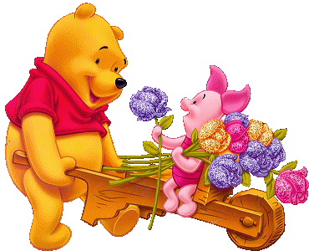
Holidays

Slide 3
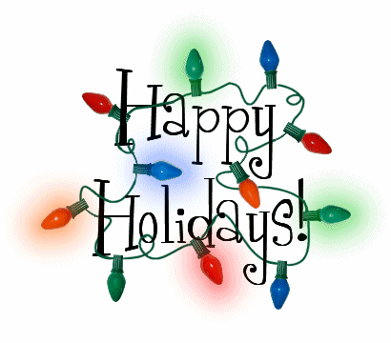
F. ex., Christmas,
St, Paretic's Day
Easter and others
days fixed by law or custom, on which ordinary business is suspended in commemoration of some event or in honor of some person

Slide 4

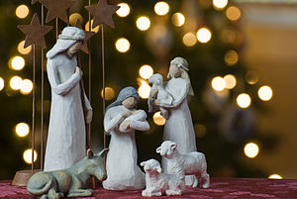
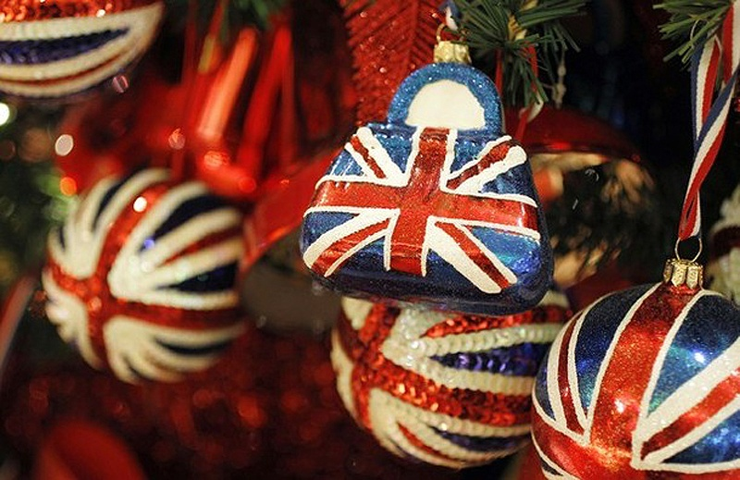
Christmas
This is the day of the celebration of
the birth of Jesus
In Britain,
Christmas is
celebrated on the
25th of December

Slide 5
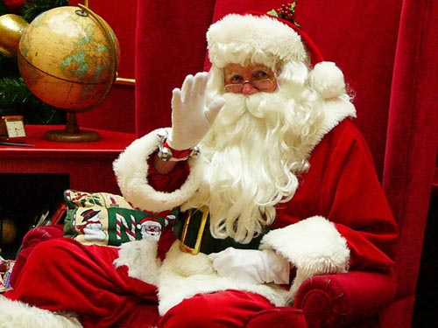
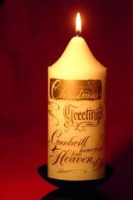

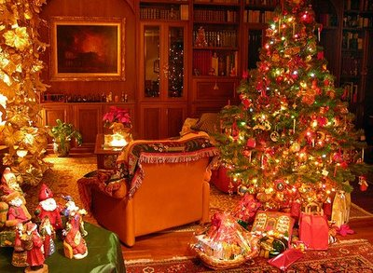
Christmas is a truly magical
holiday, bringing families and
friends to share customs and
traditions, which have been around
for centuries
Most people are on
holiday in the UK and
stay at home with their
family on Christmas day

Slide 6
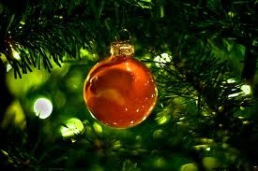
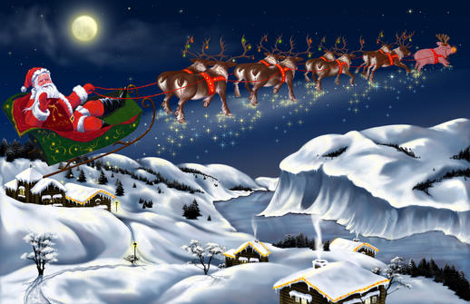
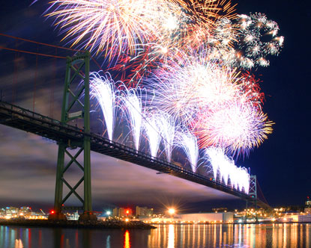
New Year
New Year's Day is the first
day of the Gregorian calendar,
which is widely used in many
countries such as the USA.
The start of New Year's Day, at
midnight, is heralded by fireworks,
parties and special events, which are often televised.

Slide 7
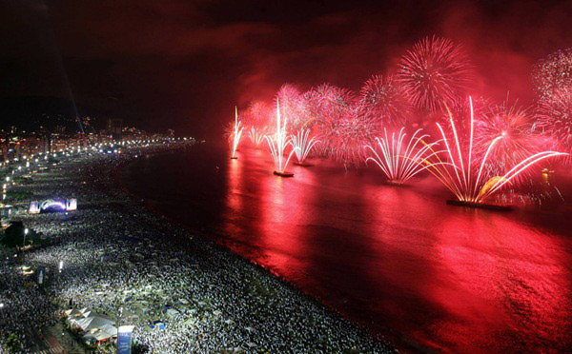
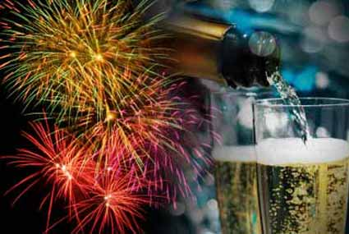
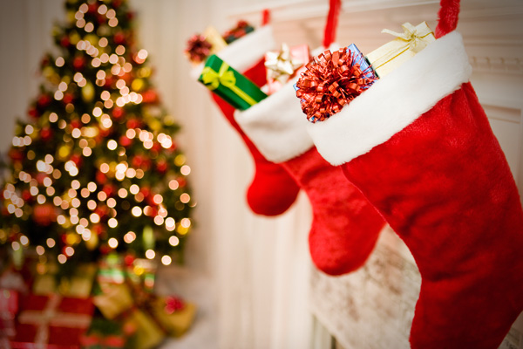
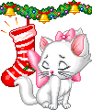
For many it is a day of recovery from the New Year's Eve celebrations the previous night.

Slide 8
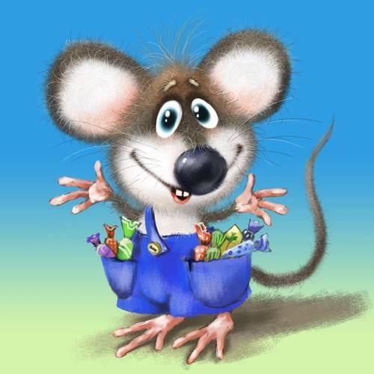
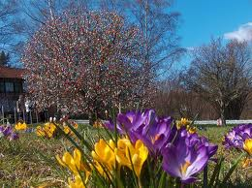
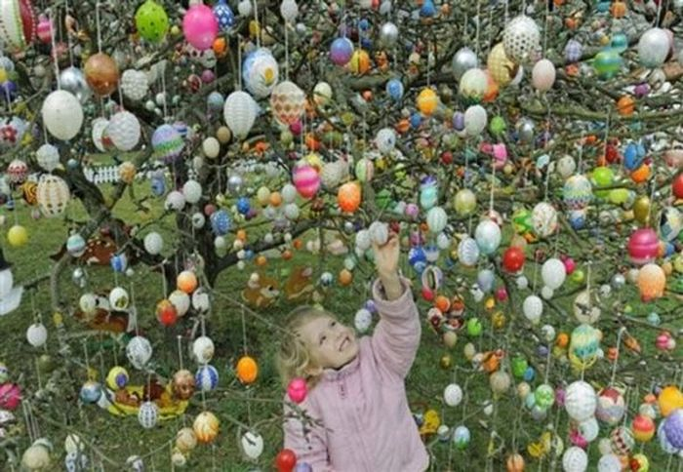
Easter
Easter Sunday is a holiday to
celebrate the Jesus Christ's
resurrection, according to the
Christian Bible.

Slide 9
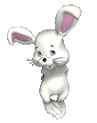
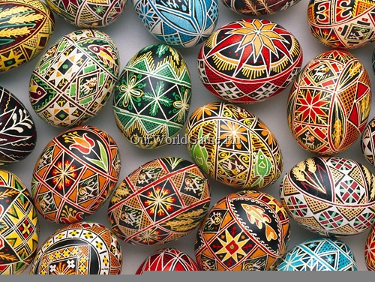
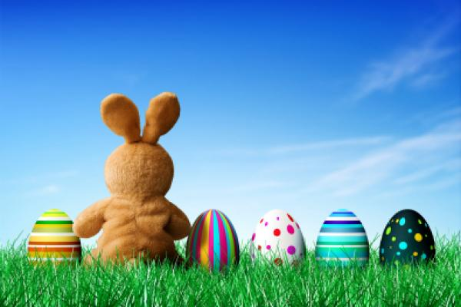
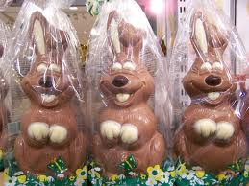
People mark the day by attending special church services, giving gifts and sharing festive meals with family members.
In Germany, many people give and receive Easter eggs and Easter hares on Easter Sunday.

Slide 10

Festivals
a day or time of religious or other celebration, marked by feasting, ceremonies, or other observances
a period or program of festive activities, cultural events, or entertainment.

Slide 11
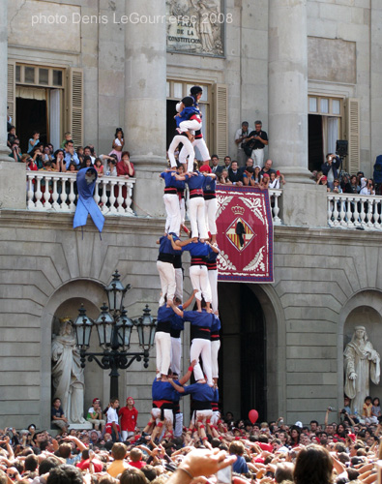
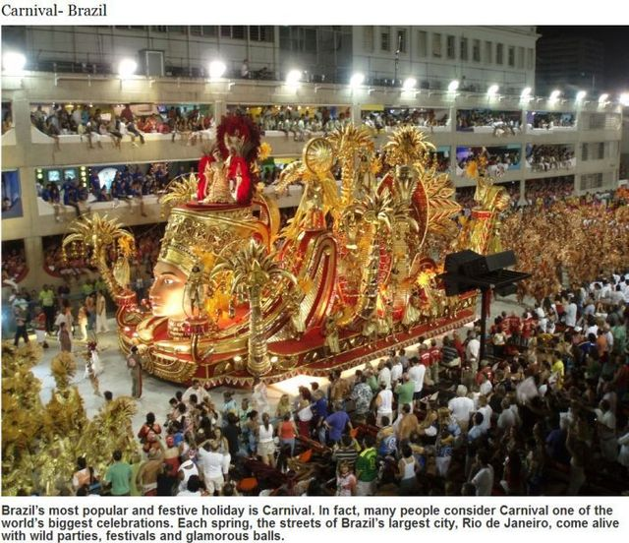
Festival of castellers(human castles) in
Barcelona
Carnival in Brazil

Slide 12
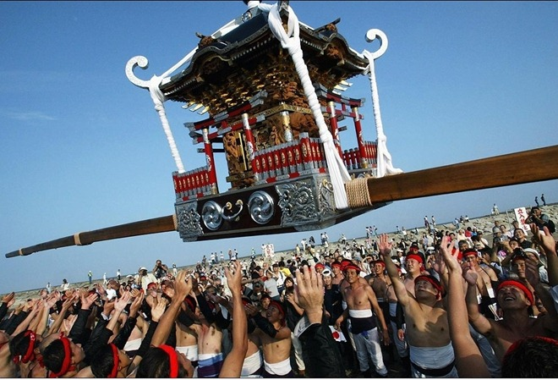
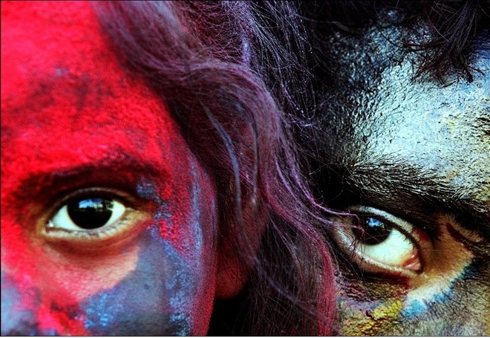
Hudak Festival in Japan
Festival of colors in India

Slide 13
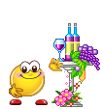
Public Bank Holidays
any of several weekdays when banks are closed; legal holidays in Britain

Slide 14
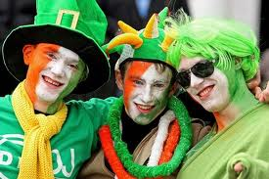
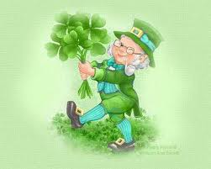
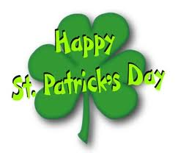
St. Patrick's Day
St Patrick’s Day is the feast day of Ireland's patron saint. It is a public holiday in the Republic of Ireland.
People throughout Ireland hold parades. The largest parade is in Dublin. Many towns and villages also have their own parades.
The shamrock is a symbol of the holiday and as well an Irish Catholic symbol of the Holy Trinity, it is a symbol of Ireland and a registered trademark of the Republic of Ireland.

Slide 15
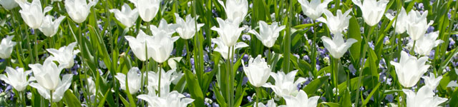
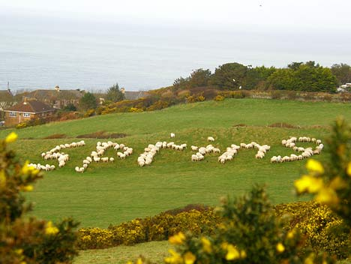
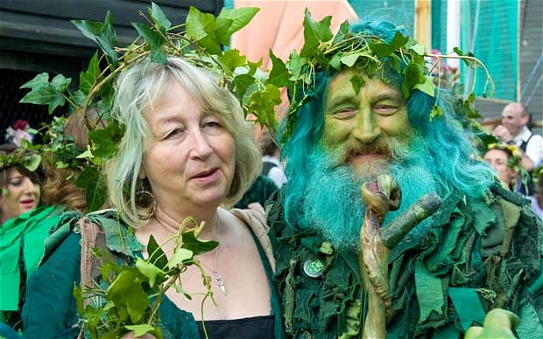
Late May bank holiday
This is the spring bank holiday, which is celebrated on the last Monday of May each year.
The holiday is a pleasant day off work or school.
Some people choose to take a short trip or vacation. Others use the time to walk in the country, catch up with family and friends, visit garden centers

Slide 16
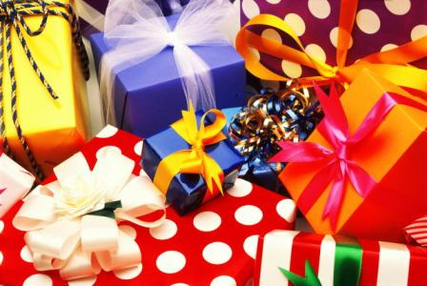
Types of holidays

Slide 17
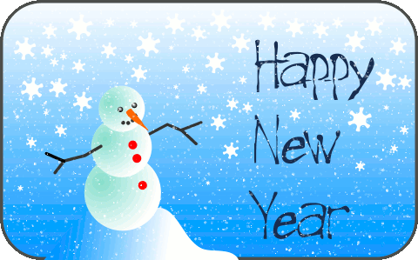
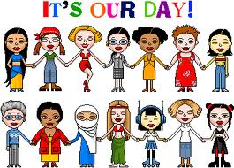
International
NEW YEAR’S DAY – 1st January
Is the time at which a new calendar year begins and the calendar's year count is incremented.
International women’s day- 8th march
Is a global day celebrating the economic, political and social achievements of women past, present and future.

Slide 18
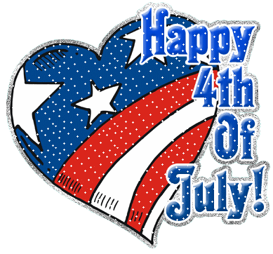
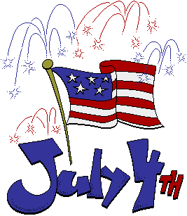
National
Independence Day is annually celebrated on July 4 and is often known as "the Fourth of July". It is the anniversary of the publication of the declaration of independence from Great Britain in 1776. Patriotic displays and family events are organized throughout the United States. Many people display the American flag on their homes. The celebrations have deep roots in the American tradition of political freedom.

Slide 19
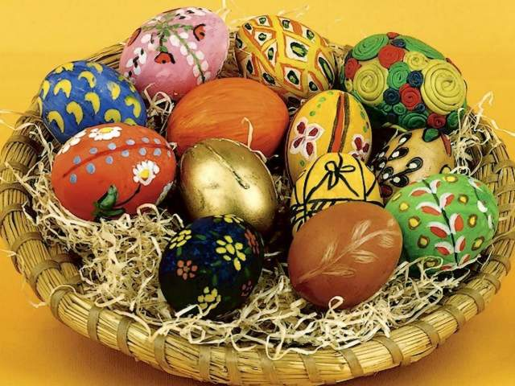
Religious
Easter
Is the springtime holiday marking the rebirth of Jesus and the renewal of the Christian faith.
It is a blessed time for the faithful to celebrate the life, death and resurrection of the Savior... and a magical time for children to enjoy chocolate bunnies, marshmallow chicks and jellybean-filled Easter eggs.

Slide 20
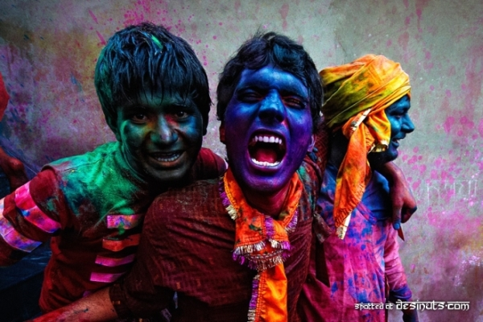
Seasonal
Holi Festival
Is a festival celebrating the arrival of spring. Holi celebrats fun and freedom giving one the opportunity to enjoy life with colours revealing our crazy self, while not forgetting the festive spirit of love and respect

Slide 21
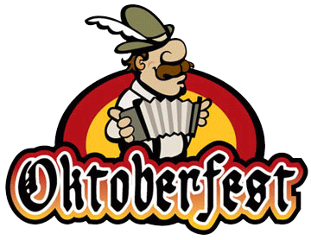
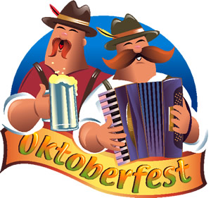
Oktoberfest is a 16-day festival celebrating beer held annually in Munich, Bavaria, Germany, running from late September to the first weekend in October. It is one of the most famous events in Germany and is the world's largest fair, To the locals, it is not called Oktoberfest, but "die Wiesn" - after the colloquial name of the fairgrounds themselves. The Oktoberfest is an important part of Bavarian culture, having been held since 1810.
Local

Slide 22
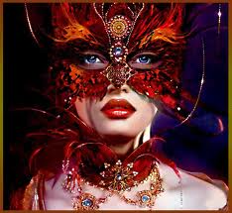
To mask
to cover with a decorative or protective mask.

Slide 23
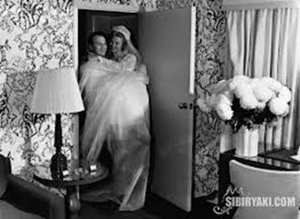
To observe
to keep or celebrate (a holiday, for example): observe an anniversary

Slide 24
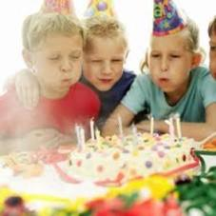
To celebrate
to observe an occasion with appropriate ceremony or festivity.
To perform a religious ceremony.
To engage in festivities: went out and celebrated after the victory.

Slide 25
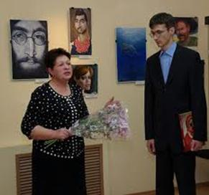
To commemorate
to honor the memory of with a ceremony. See Synonyms at observe.
2. To serve as a memorial to.

Slide 26
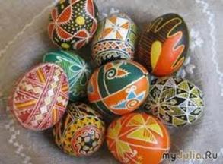
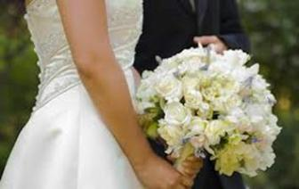
To preserve, to keep tradition
to keep in perfect or unaltered condition; maintain unchanged.

Slide 27
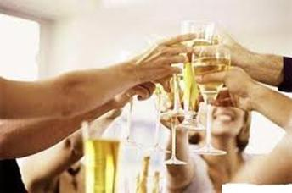
To recognize an occasion, data
to know to be something that has been perceived before

Slide 28
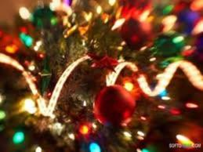

To honour
1. to hold in respect or esteem
2. to show courteous behaviour towards
3. to worship

Slide 29


to hold a demonstration
to carry out

Slide 30


to sponsor a parade
To pay all or part of the cost of putting on a parade

Slide 31

to give a party (to throw a party) (colloq.)
to organize a social gathering for pleasure, often held as a celebration

Slide 32

to demonstrate labor solidarity
to express feelings of fellowship arising from common responsibilities and interests

Slide 33

to have family get together
to organize a meeting of all members of the family

Slide 34

merry-making
a participation in festive activities

Slide 35

to give presents (BE), gifts (AE)
to give someone something pleasant with meaning and purpose.

Slide 36

to send greeting cards, Valentine cards
to send illustrated, folded cards given on special occasion or holiday to express personal greetings

Slide 37

to go treat or tricking
to travel from house to house in order to ask for treats such as candy (or, in some cultures, money) with the question "Trick or treat?" on Halloween in USA.

Slide 38

to ask a penny for the guy
to take the home-made guys out on the street
and ask for money for fireworks
during the days before Bonfire Night in Britain

Slide 39

to have bonfires
to make the sort of large outdoor fire which often lit as part of various festivals and ceremonies around the world

Slide 40

to lay wreaths
to put on a grave a circle of flowers or leaves to show that you are remembering the dead person

Slide 41


New Year's Day falls on
January 1 and marks the start of a new year according to the Gregorian calendar.
It marks the end of
New Year's Eve celebrations in the United States and gives many Americans a chance to remember the previous year.
Constituent parts of national celebrations
New Year

Slide 42





Here some traditions of Celebrating New Year
New Year tree decorations (BE);
trimmings (AE);
small lights

Slide 43






Traditions of Celebrating New Year
fairy-lights;
baubles;
glitter;
evergreen;
wreaths of evergreen;
garlands

Slide 44







Traditions of Celebrating New Year
holly;
mistletoe;
fir-cones;
bonfires;
fireworks;

Slide 45





Traditions of Celebrating New Year
the flying of flags,
balloons and paper streamers;
horns;
party-poppers;

Slide 46






Traditions of Celebrating New Year
Santa Claus and his reindeer.
Father Frost and Snow Maiden;
stockings (for presents)

Slide 47



Halloween
Halloween or Hallowe'en (a contraction of "All Hallows' Evening"), also known as All Hallows' Eve, is a yearly celebrationobserved in a number of countries on October 31, the eve of the Western Christian feast of All Hallows (or All Saints).

Slide 48





Traditions of Halloween
dressing up;
fancy dress balls;

Slide 49






Traditions of Halloween
witches;
ghosts;
jack-o-lanterns

Slide 50


There are plenty of gifts we may present on different occasions, on such holidays as:
New Year
Birthday
Easter
St. Valentine's Day

Slide 51







New Year
:
Dolls
Cars
Candies

Slide 52





Easter
Chocolates
Eggs
Biscuits

Slide 53





St. Valentine’s Day
Hearts
Candies
Souvenirs
Roses

Slide 54






Birthday
Flowers
Toys
Sweets
Jewelry

Slide 55

Special celebration foods

Slide 56


Christmas foods
Food is the centerpiece of most holidays,but that is especially true during the Christmas!

Slide 57

The Christmas bird
Say “turkey” and, in the minds of many people, you’ll conjure up a mental image of a table laden with roast turkey, vegetables, gravy and all the other favorites eaten at Christmas.
The turkey appeared on Christmas tables in England in the 16th century, and popular history tells of King Henry VIII being first English monarch to have turkey for Christmas.

Slide 58

No British Christmas is complete without a Christmas Pudding!
Christmas pudding is a traditional English dish, which has spread to other English-speaking countries, such as Australia.
This boiled or steamed pudding is also called
plum pudding, plum duff, bag pudding or boiled pudding.

Slide 59

This chocolate log is a chocolate roulade covered in a chocolate fudge. It makes a fantastic dessert to put on a dinner table around Christmas!

Slide 60

Easter eggs
Eggs have been viewed as symbols of new life and fertility through the ages.
It is believed that for this reason many ancient cultures, including the Ancient Egyptians, Persians, and Romans, used eggs during their spring festivals.

Slide 61

Roasted Chestnuts
For certain families, Thanksgiving and Christmas dinners are never complete without chestnuts roasting in the oven — served after dessert, as the very final course with fruit, such as clementines and dried figs.

Slide 62

Mulled wine
Mulled wines are very much associated with the festival Christmas.
Over recent years, mulled wine has become more popular again, frequently being drunk at festive occasions and at parties too. There are many recipes that are used to make this wine, with people experimenting to find the taste that is preferable to them. The ingredients are nearly always natural, thus enhancing the health benefits of mulled wine.

Slide 63

Folklore
is a general term for different varieties of traditional narrative

Slide 64



There are several types of folklore:
Verbal
Partly verbal
Non-verbal

Slide 65

To VERBAL folklore belong:
proverbs
rhymes
myths
legends
folksongs
ballads

Slide 66

To PARTLY VERBAL folklore belong:
superstitions
customs and festivals
folkdances
games

Slide 67


To NON-VERBAL folklore belong:
folk gestures
folk music
folk architecture
handicrafts
folk costumes
foods

Slide 68





Rite
religious or other solemn
ceremony
2. is an established,ceremonious,usually
religious act

Slide 69




Ceremony
1. is an event of ritual significance,performed on a special occasion
2. formal act or series of formal acts performed on a religious or public occasion

Slide 70


Ritual
1.is a series of actions used in a rilligious or some other ceremony
2. procedure regularly followed in precisely the same way each time

Slide 71



Customs
usually generally accepted and long established way of behaving or doing things

Slide 72


Tradition
passing of beliefs or customs from one generation to the next, especially without writing

Slide 73




Festivals
day or time of religious or other celebration

